Slide 1
Mybank banking application

Slide 2
Module : loan application
Introduction
Project structure
Database design
Data flow diagram

Slide 3

Introduction
The MyBank project is a comprehensive banking system that manages various aspects of banking operations. It consists of several modules, each designed to handle specific banking services
Loan module: These modules manage the details of the loans available and availed by the customers in my bank
These module include loan ID, type, name, description, ROI, amount, EMI, and tenure.

Slide 4
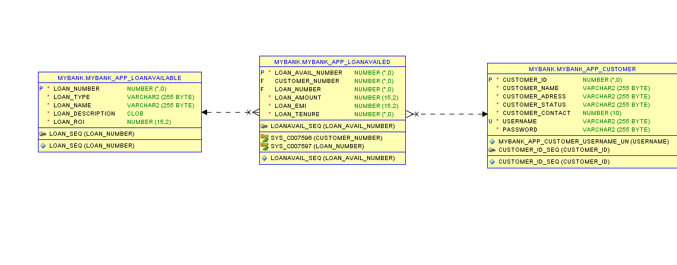
DATABASE DESIGN

Slide 5
Rest services
Adding new loan for a customer, using post method

Slide 6
This module that integrates with the mybank_app_loan system to facilitate the addition of new loan records.
The module should be capable of sending a POST request to the mybank_app_loan API with the necessary loan details provided by the user.
All the errors should be handled , if the account is inactive the customer shouldn’t be able to take a new loan

Slide 7
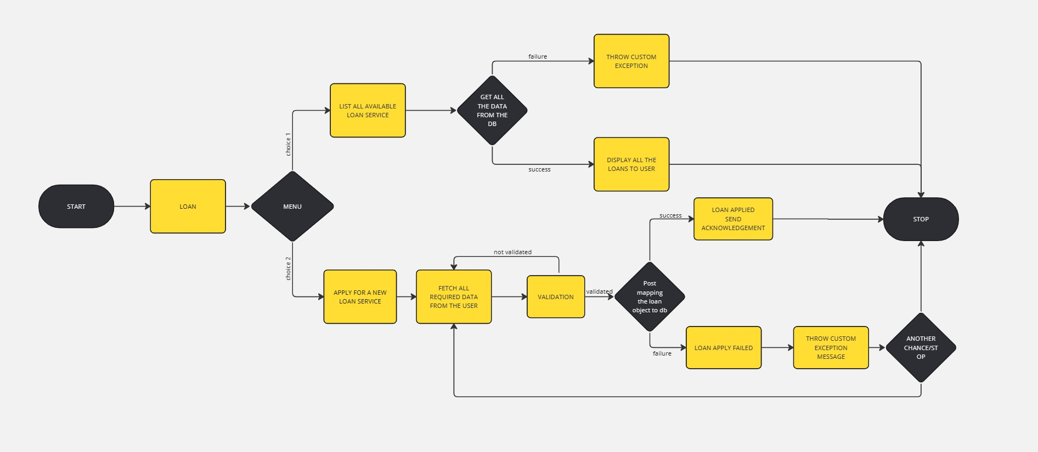
Flow diagram​

Slide 8
GITHUB LINKS
Webservice
DAO-MYBANK

Slide 9
THANK YOU

Slide 10
Know your material in advance​
Anticipate common questions​
Rehearse your responses
Maintaining composure during the Q&A session is essential for projecting confidence and authority. Consider the following tips for staying composed:​
Stay calm​
Actively listen​
Pause and reflect​
Maintain eye contact

Slide 11

Speaking impact​
Your ability to communicate effectively will leave a lasting impact on your audience​
Effectively communicating involves not only delivering a message but also resonating with the experiences, values, and emotions of those listening

Slide 12
Dynamic delivery​
Learn to infuse energy into your delivery to leave a lasting impression​
One of the goals of effective communication is to motivate your audience
Metric​ | Measurement​ | Target​ | Actual​
Audience attendance​ | # of attendees​ | 150​ | 120​
Engagement duration​ | Minutes​ | 60​ | 75​
Q&A interaction​ | # of questions​ | 10​ | 15​
Positive feedback​ | Percentage (%)​ | 90​ | 95​

Slide 13
Final tips & takeaways​
Consistent rehearsal​
Practice makes perfect, so strengthen your familiarity with the presentation​
Refine delivery style​
Pacing, tone, and emphasis​
Timing and transitions​
Aim for seamless, professional delivery​
Practice audience
Enlist colleagues to listen & provide feedback​
Seek feedback​
Reflect on performance​
Explore new techniques​
Set personal goals​
Iterate and adapt

Slide 14
Speaking engagement metrics​
Impact factor​ | Measurement​ | Target​ | Achieved​
Audience interaction​ | Percentage (%)​ | 85​ | 88​
Knowledge retention​ | Percentage (%)​ | 75​ | 80​
Post-presentation surveys​ | Average rating​ | 4.2​ | 4.5​
Referral rate​ | Percentage (%)​ | 10​ | 12​

